Slide 1

Mechandise for the Shop

Slide 2
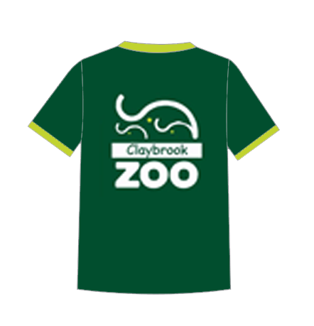
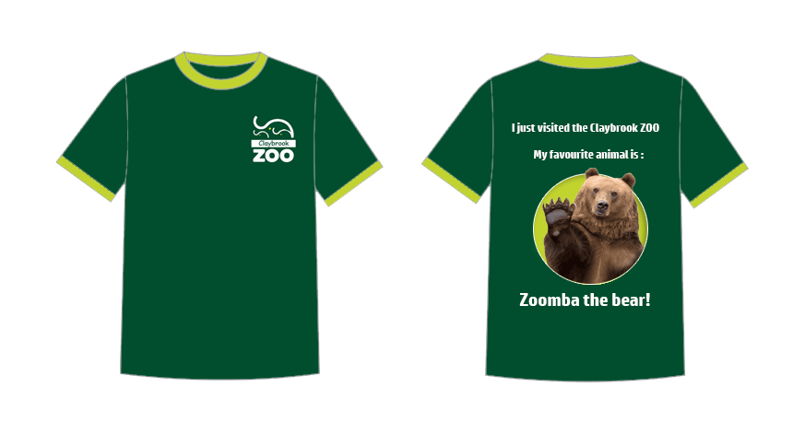
T-shirts
Adults Children

Slide 3
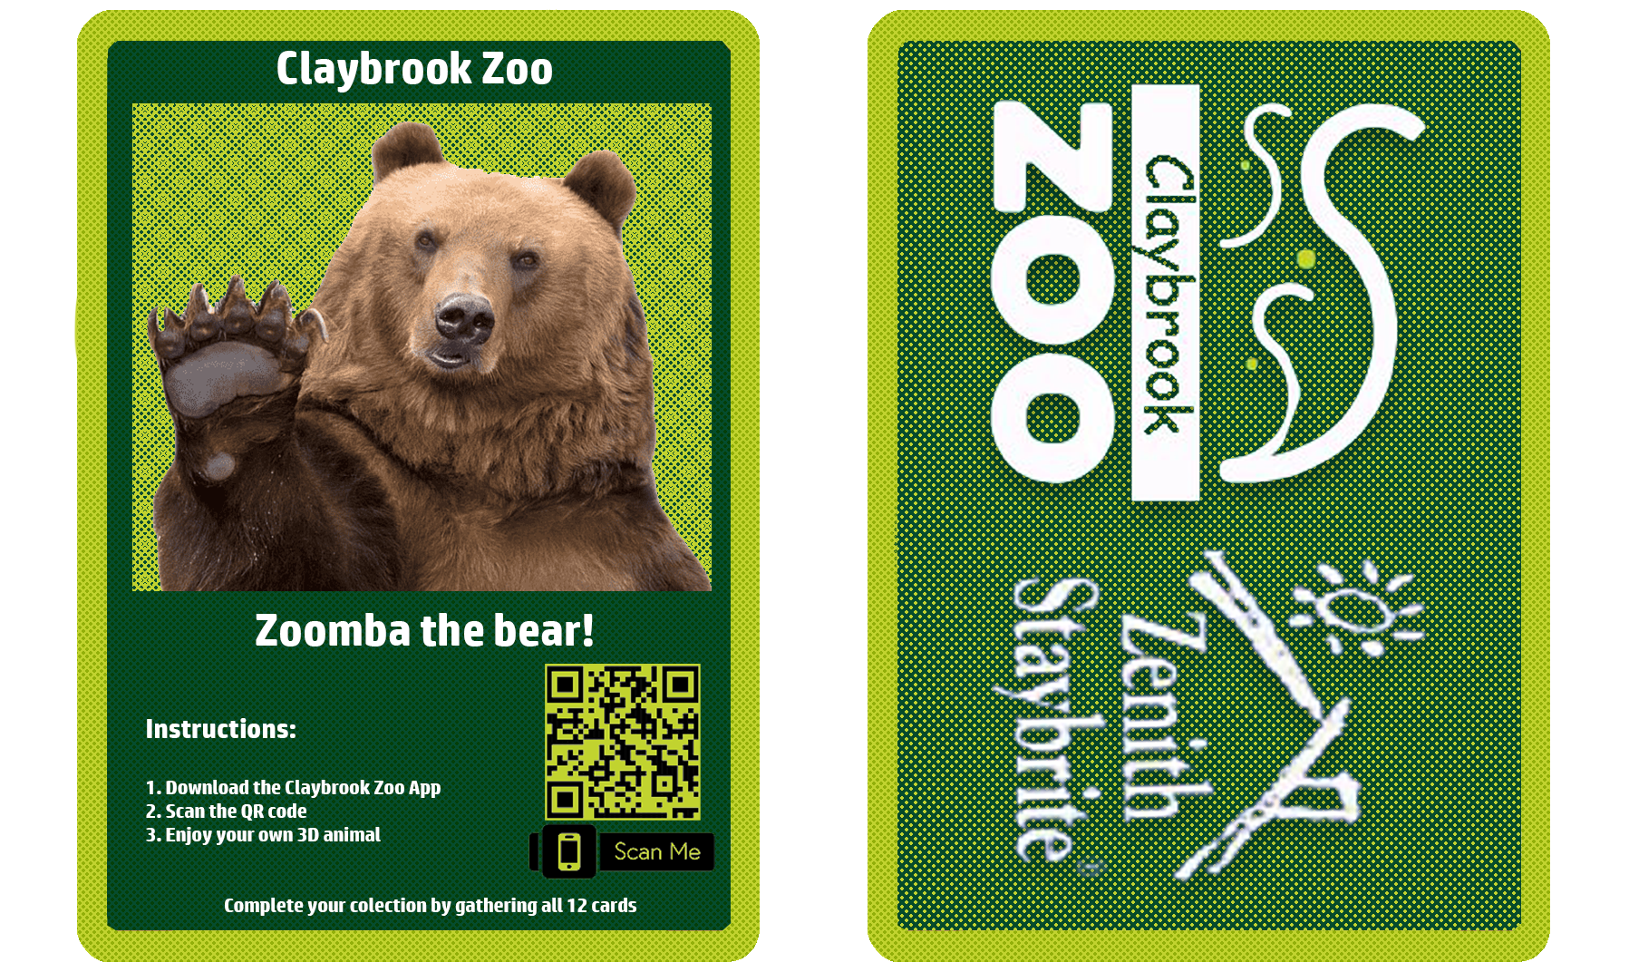
Qr cards: 1. Design

Slide 4
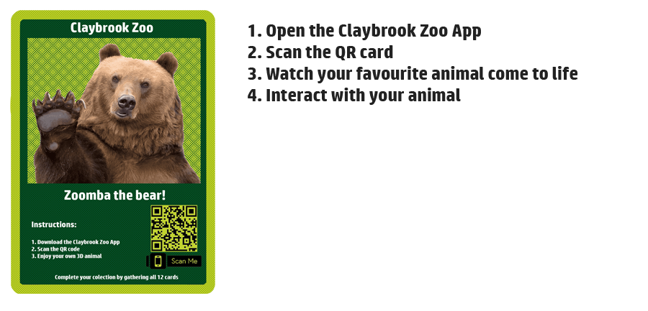

2. How it works

Slide 5
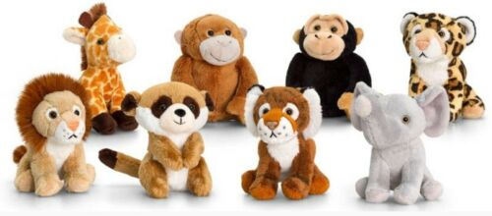
Additional merchandise
1. Stuffed pets from the zoo

Slide 6
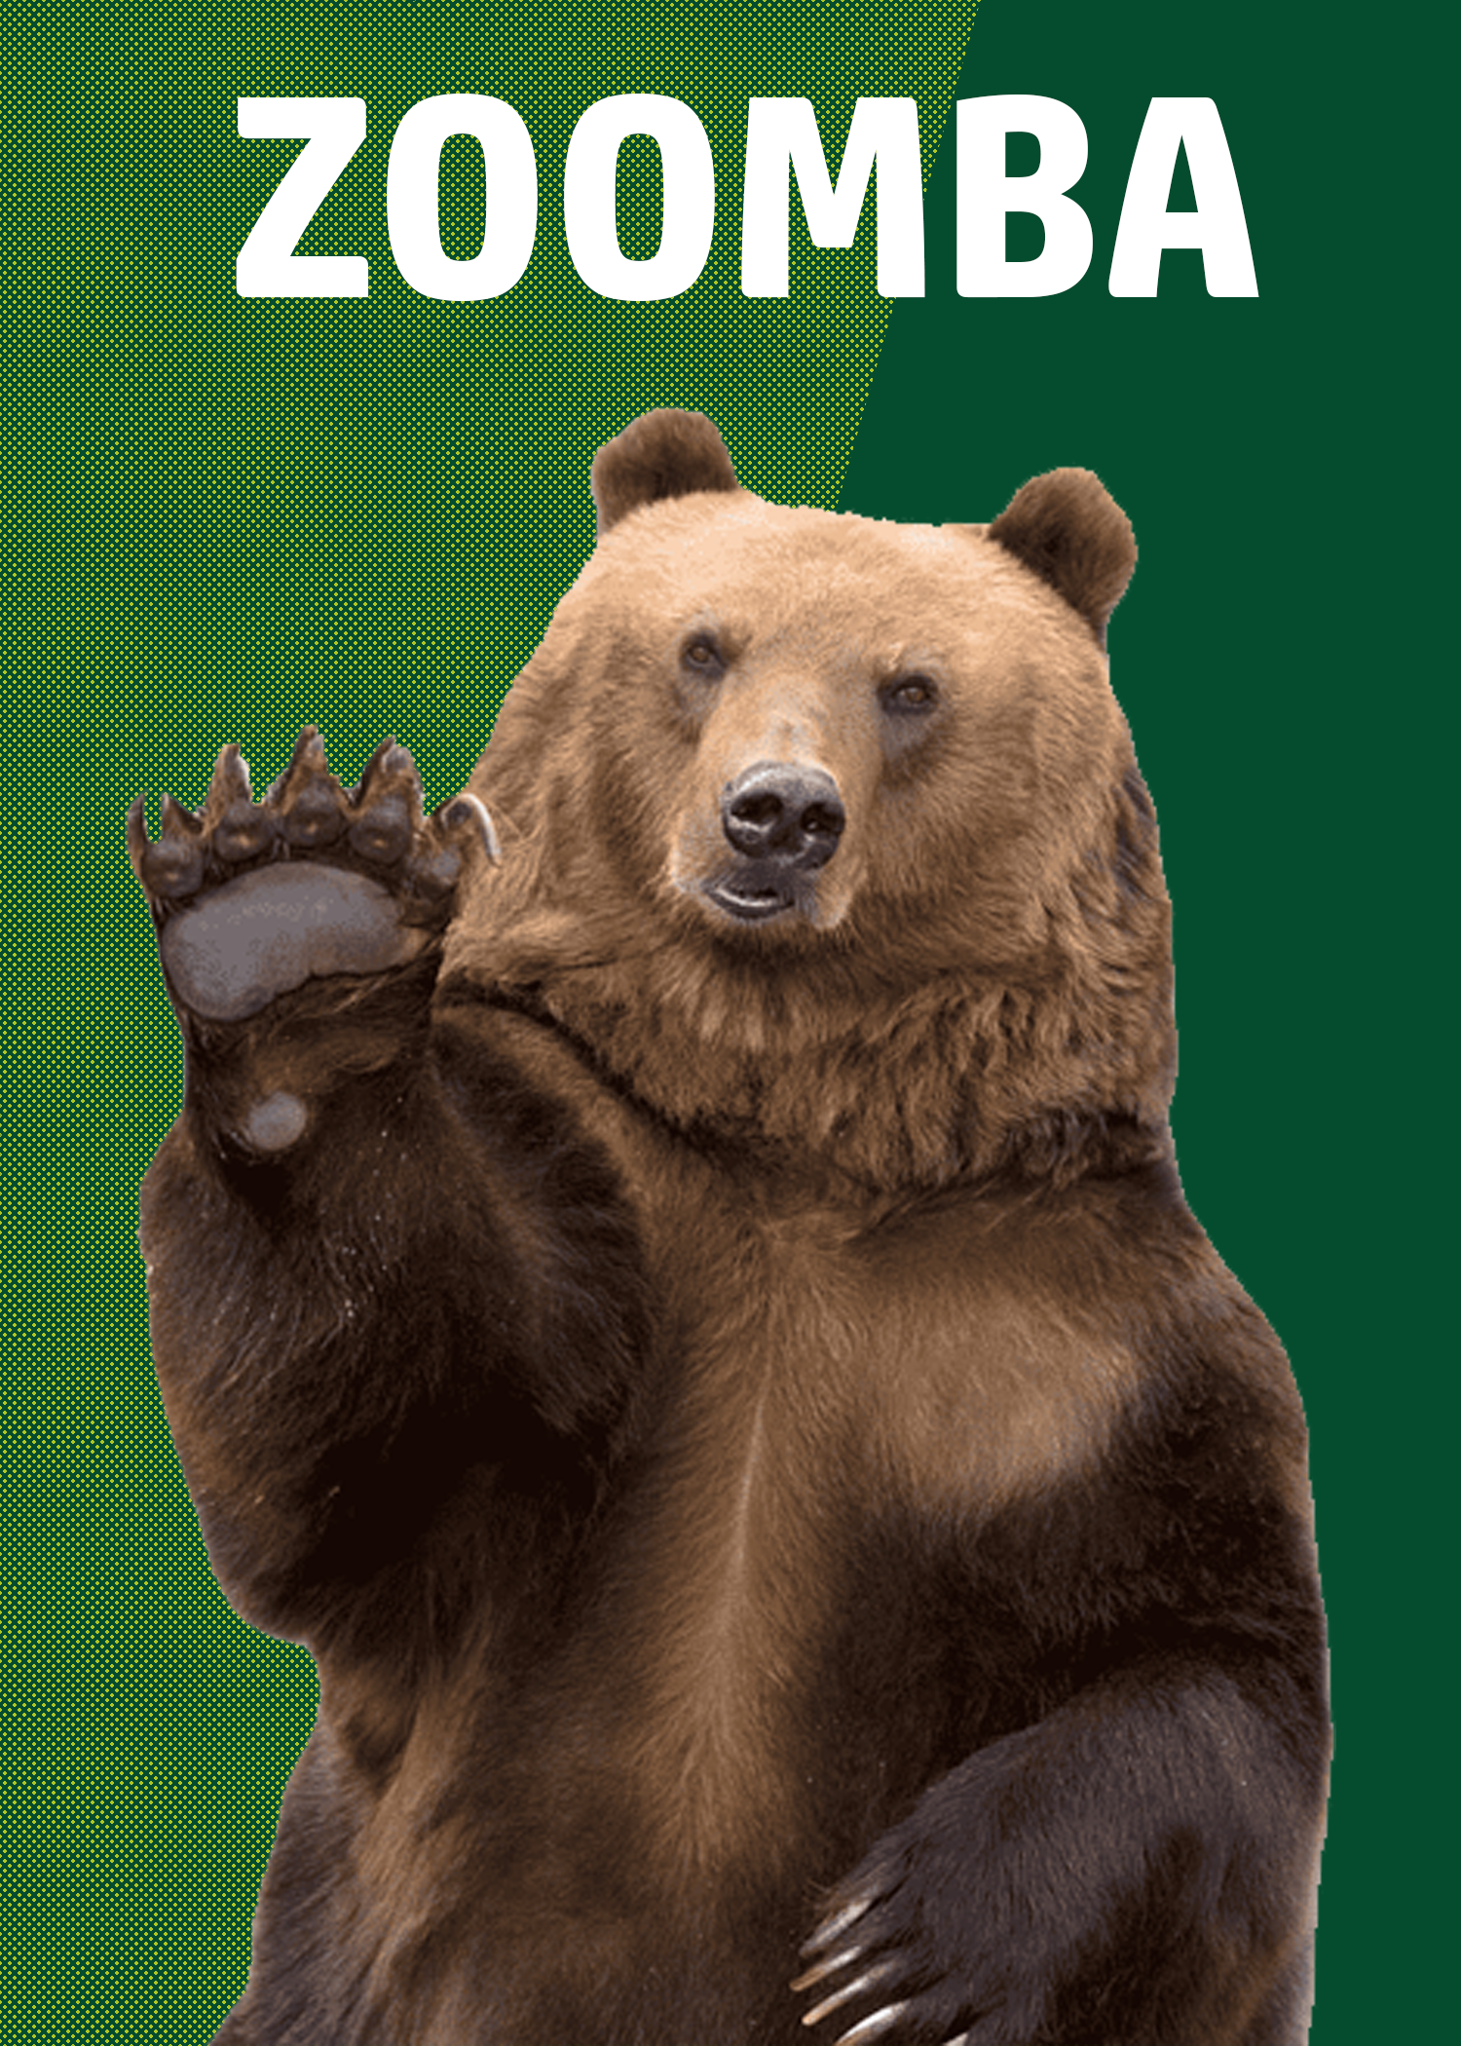
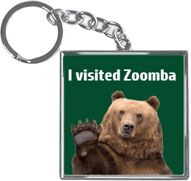
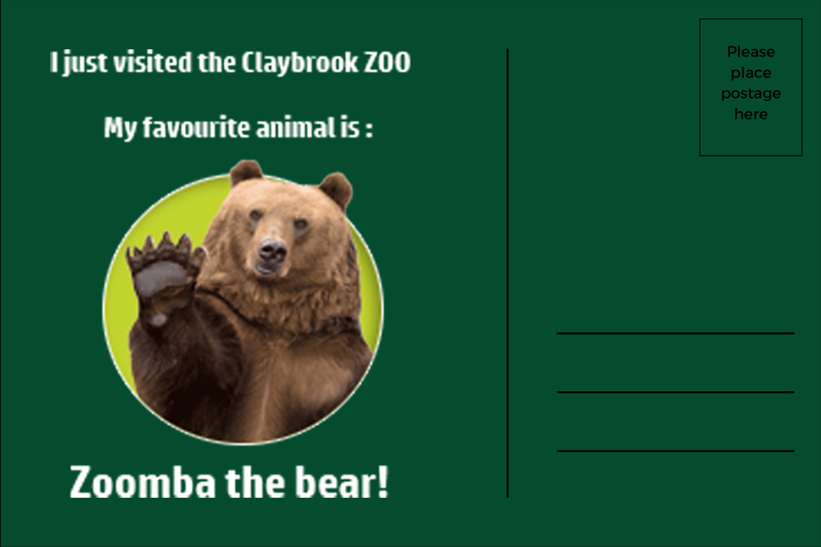


Small memorabilia:
Postcards
Keychains
Posters

Slide 7
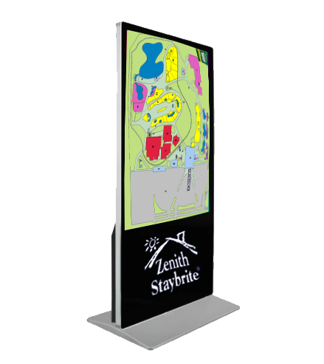

Sponsorship

Slide 8
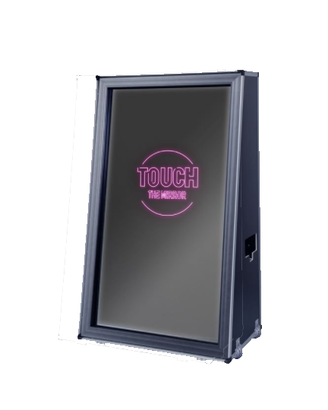
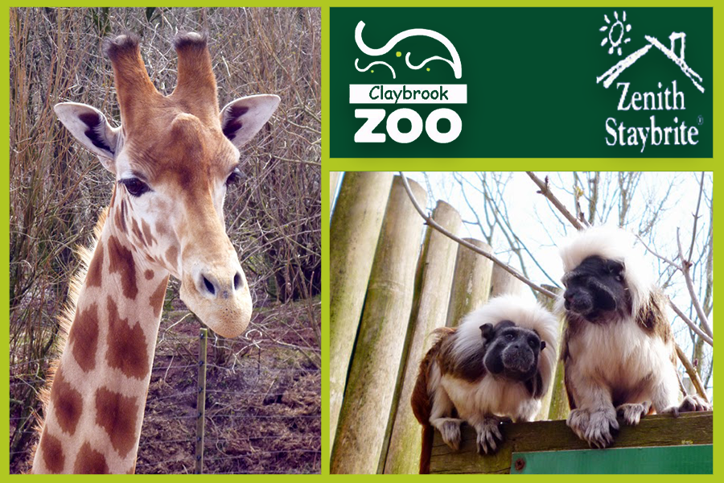
Magic Mirror
Take cheap pictures from the zoo
Printable cards with personalized logos, designs

Slide 9
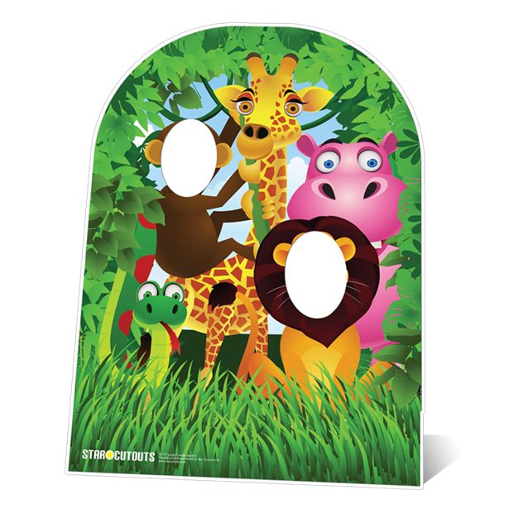
Cardboard Cut outs for children

Slide 10
Bibliography
PNGitem.com. 2021. Transparent Tshirt Outline Png - T Shirt Template White Png, Png Download , Transparent Png Image - PNGitem. [online] Available at: <https://www.pngitem.com/middle/ThRxmw_transparent-tshirt-outline-png-t-shirt-template-white/> [Accessed 15 November 2021].
eBay. (n.d.). Keel Toys Mini Wild Safari Zoo Animals 12cm Soft Plush Toys. [online] Available at: https://www.ebay.co.uk/itm/203308513882?chn=ps&mkevt=1&mkcid=28&var=503963265755 [Accessed 15 Nov. 2021].
me-qr.com. (n.d.). QR code generator - free | Make QR code for link, image or PDF file - ME-QR. [online] Available at: https://me-qr.com/?bannerid=6073639866&gclid=Cj0KCQiAhMOMBhDhARIsAPVml-GLhOCK155bhDTTtad9SOvohKg6mwK-3In-QMZvtO_EohUOec9sbYoaAqnzEALw_wcB [Accessed 15 Nov. 2021].
‌www.youtube.com. (n.d.). Grizzly bear 3D. [online] Available at: https://www.youtube.com/watch?v=EjdSCCnGhgs&list=PPSV&ab_channel=AndreaUmbertoOriglia [Accessed 15 Nov. 2021].
‌Made-in-China.com. (n.d.). [Hot Item] Indoor 55 Inch Free Standing LCD Digital Signage 4K Touch Screen Interactive Totem Kiosk. [online] Available at: https://aiyostech.en.made-in-china.com/product/HyOEFAxJbukS/China-Indoor-55-Inch-Free-Standing-LCD-Digital-Signage-4K-Touch-Screen-Interactive-Totem-Kiosk.html [Accessed 15 Nov. 2021].
‌vhv.rs. (n.d.). Buty Snowboardowe Burton Damskie, HD Png Download - vhv. [online] Available at: https://www.vhv.rs/viewpic/ThJRxTJ_buty-snowboardowe-burton-damskie-hd-png-download/ [Accessed 15 Nov. 2021].
‌magic-mirror.com. (n.d.). Magic Mirror Model London. [online] Available at: https://magic-mirror.com/models/magic-mirror-photobooth-mirror-model-london/ [Accessed 15 Nov. 2021].
‌Toon, N.G. in (n.d.). South Lakes Wild Animal Park. [online] New Girl in Toon. Available at: https://www.newgirlintoon.co.uk/2014/06/south-lakes-wild-animal-park.html [Accessed 15 Nov. 2021].
‌www.partydelights.co.uk. (n.d.). Jungle Friends Stand In Photo Prop - 1.2m | Party Delights. [online] Available at: https://www.partydelights.co.uk/product-detail.aspx?ProductID=CUTO378&gclid=CjwKCAiAp8iMBhAqEiwAJb94zxnBnBD6eMVGfAGQbDevoRnlxpge--_VZSRWjz3OPA8aqCuU4Xqf-RoCU9AQAvD_BwE [Accessed 15 Nov. 2021].
‌

